Slide 1


Slide 2

Not able to understand what is scrolling. Please check

Slide 3
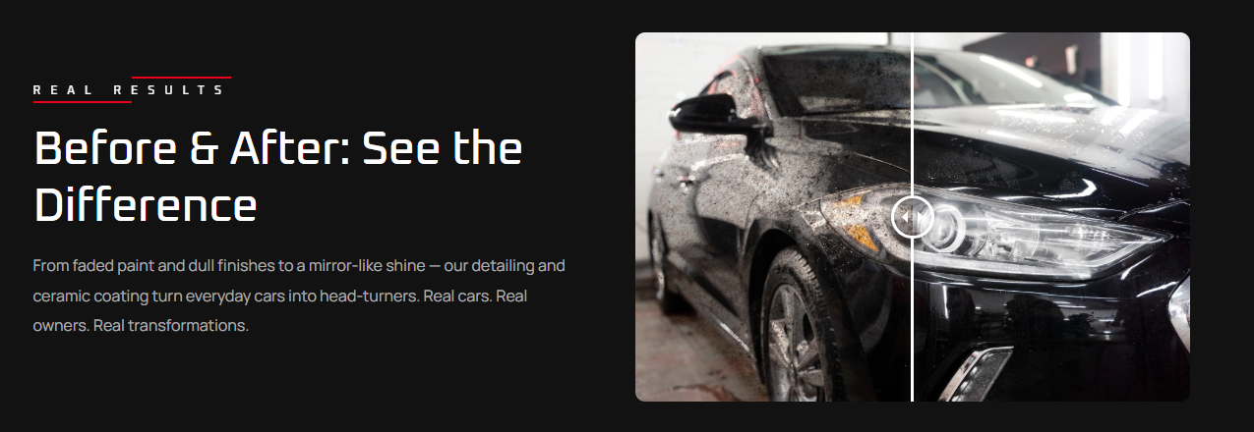
Not working properly. Difference is not clear and only one image is appearing

Slide 4
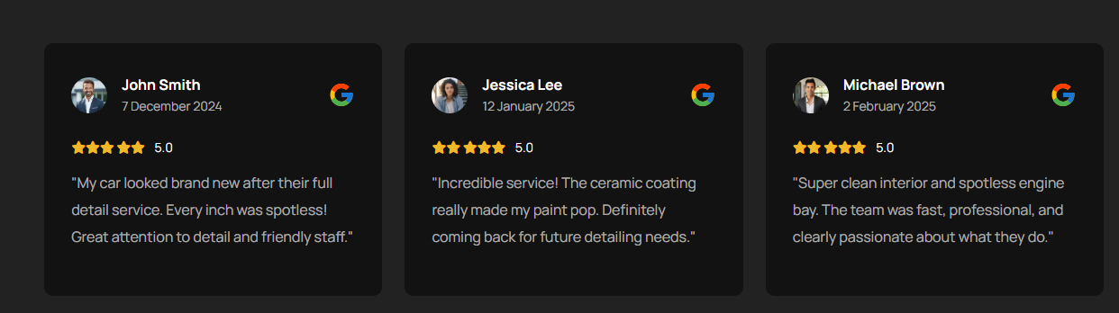
All names are of foreigner. We will provide name of our real customer which should be incorporated.

Slide 5
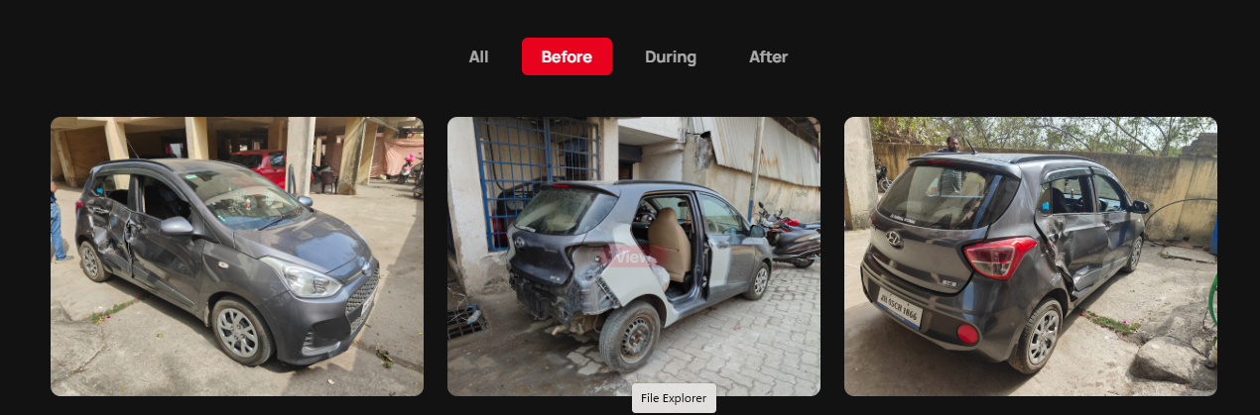
Gallery should be corrected. Put pictures of different vehicles in before, then put progress pictures of those vehicles in during and final pictures in after. Also select pictures which are showing maximum coverage for final look in ‘After’ menu

Slide 6
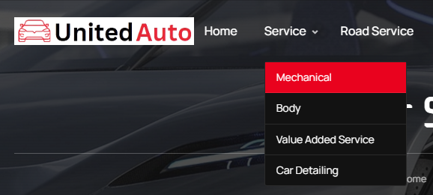
No description is appearing under these drop down. We have provided you slides with details of services. You have not mentioned any thing. Please go through our power point slides once.

Slide 7

No details mentioned under this head. We have already provided details in our presentation file name : united auto website_rev1. Please check and revise accordingly.

Slide 8
Serviceable Brand
Serviceable Brand
MARUTI
HYUNDAI
TATA MOTORS
MAHINDRA
TOYOTA
Ford
Fiat
Jeep
Serviceable Brand
Chevrolet
Honda
Skoda
VW
Renault
Marcedes
Audi
BMW
Mitsubishi
It should be appeared before Home and all the brands in Drop Down under Serviceable Brand.
You can suggest any suitable word also for “Serviceable brand”
This head is not mentioned in your site. Please incorporate as mentioned in notes.

Slide 9
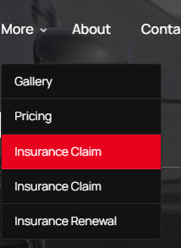
Put our pricing chart under this head, which we have already provided you in our presentation file
Insurance head should be appeared separately not under More. Please check our power point slide and correct accordingly.

Slide 10
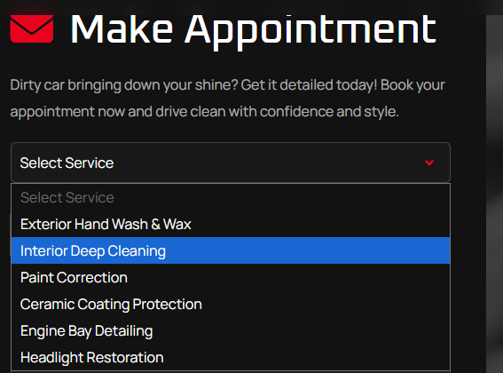
Select Services : all the service head mentioned in our presentation file should be appeared here. Please do necessary changes. It is very important part

